Slide 1
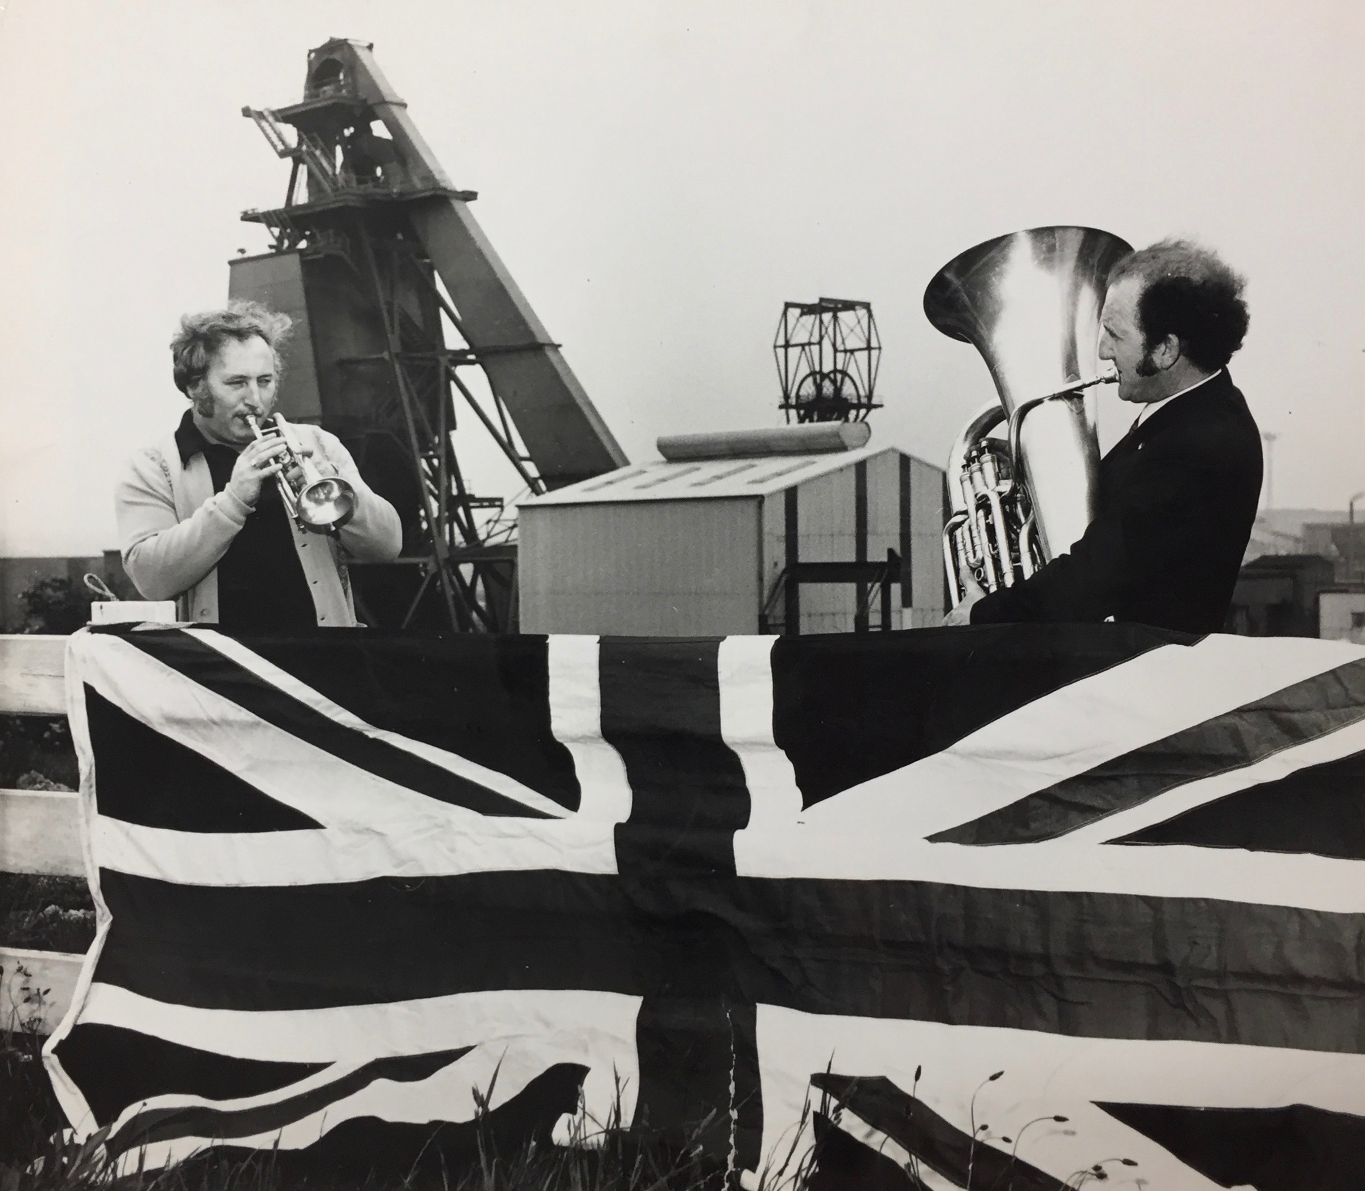
Représenter la communauté : brass bands et identités au sein des bassins miniers britanniques (1947-fin des années 1950)
Source: Barnsley Archives, Yorkshire, Royaume-Uni, Grimethorpe Colliery Band Records (1930-1986)

Slide 2
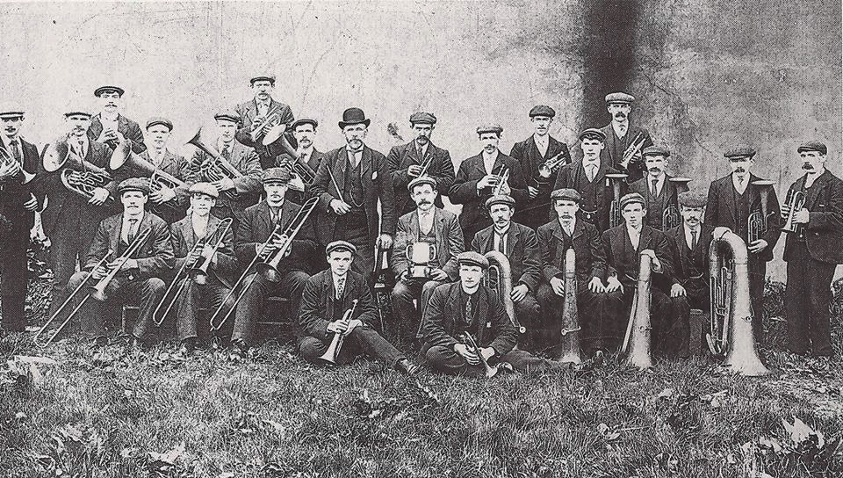
Les brass bands miniers: un objet d’histoire sociale et politique
Le Cowdenbeath Silver Band, Fife, Écosse en 1910 (source privée).

Slide 3
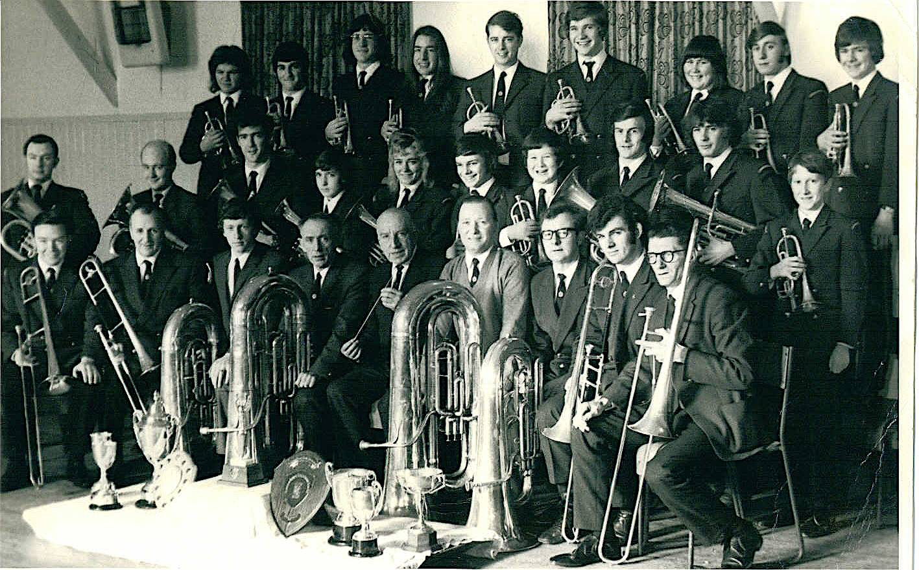
Le Cowdenbeath Silver Band, Fife, Écosse dans les années 1970 (source privée).

Slide 4
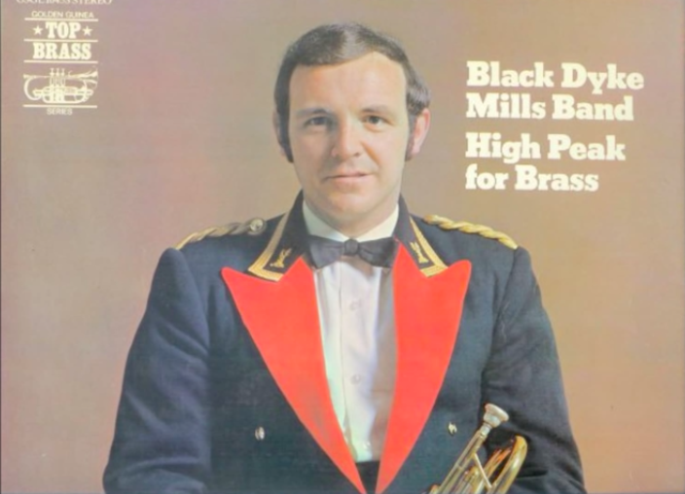
Jim Shepherd jouant le solo de cornet de « Pandora » composé par E. Damare en 1970 : https://www.youtube.com/watch?v=HanKJ2o6Q6M.

Slide 5
« The normal repertory of the brass band depends largely on arrangements, and a good deal of music specially written for it is not of high standard. The general effect of the movement is to encourage musical activity among a large section of the population and to develop individual skill in performance, but not to promote good taste to a love for music in general». Collins Encyclopedia of Music (1991, p. 85), édition originale de 1959, révisée en 1976.

Slide 6
«A roll call of the bands is like an evocation of industrial history. From Wingates Temperance and Black Dyke Mills to more modern conglomerates… Grown men, old bandsmen say, have been known to cry at the beauty of it all… Of all the manifestations of working-class culture, nothing is more certain than a brass band to bring on an attack of the George Orwells. Even the most hardened bourgeois cannot resist romanticising the proletariat a little when faced with one. ». The Times, October 11, 1974

Slide 7
Les types de brass bands miniers pendant la période
Des town bands ou public bands liés à un localité
Ex: Cowdenbeath Silver Band
Des colliery bands liés à une mine
Ex: Grimethorpe Colliery Band
Des welfare bands liés à un welfare club local
Ex: Arley Welfare Band

Slide 8
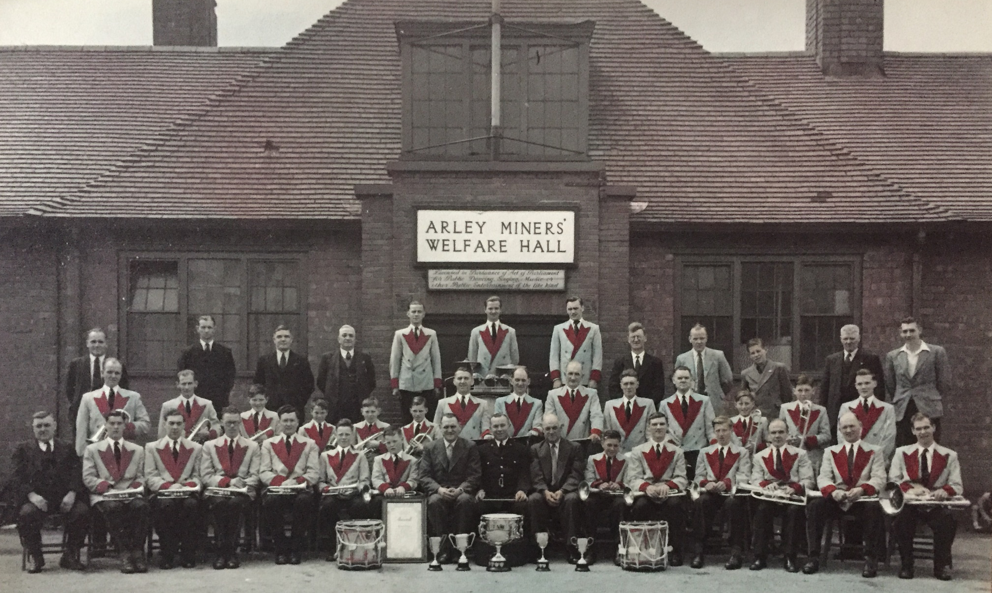
Le Arley Miners’ Welfare Band, West Midlands, dans les années 1950 (source privée)

Slide 9
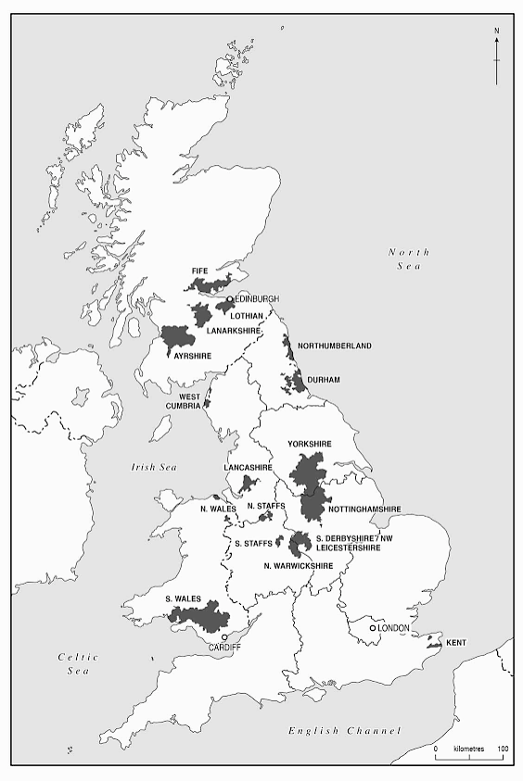
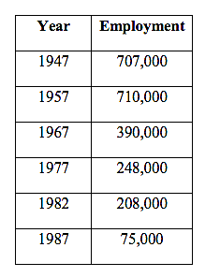
Les divisions géographiques du National Coal Board (NCB) en 1947
Source: Huw Beynon and Ray Hudson, The Shadow of the Mine: Coal and the End of Industrial Britain (London: Verso, 2021), 15.
Évolution de la main d’œuvre dans l’industrie minière britannique

Slide 10
1er janvier 1947: Nationalisation de l’industrie minière britannique
National Coal Board (NCB, 1947)
National Union of Mineworkers (NUM, 1945)
Coal Industry Social and Welfare Organisation (CISWO, 1952)
“social welfare”

Slide 11
1) Représenter la communauté : le rôle central des brass bands dans la vie publique locale
2) Représenter une industrie minière britannique unie dans les premières années de la nationalisation

Slide 12
1) Représenter la communauté : le rôle central des brass bands dans la vie publique locale
Ruth Finnegan
The colliery band enters fully into the life of the town. It provides entertainment for the people of Ashton. The band will play at charity concerts, at garden fêtes and carnivals, at parades. People feel it is “our band”. Its appearance is expected at minor celebrations organized in, and affecting only quite a small neighborhood of two or three streets.
Dennis, Henriques, Slaughter, Coal Is Our Life, 1956, p. 120.

Slide 13
1) Représenter la communauté : le rôle central des brass bands dans la vie publique locale
a) Fêtes et carnavals locaux
Whit Walks
Miners’ galas
Commémorations

Slide 14
1) Représenter la communauté : le rôle central des brass bands dans la vie publique locale
a) Christmas Carols

Slide 15
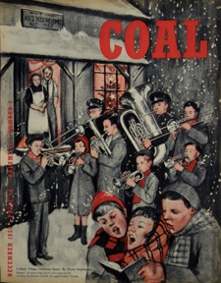
1) Représenter la communauté : le rôle central des brass bands dans la vie publique locale
b) Christmas Carols
Coal, décembre 1959.

Slide 16
1) Représenter la communauté : le rôle central des brass bands dans la vie publique locale
b) Christmas Carols
“There’s a picture of them with cap lamps on I think and they went ‘round the village on Christmas day playing Christmas Carols and that would have been… that might have been during the Second World War because they were told by the kind of local policeman (…) to put their lights out you know they were frightened that the bombers would see the light em so they put their lights out. Then, they said they got to the end of the street and they put them back on again! And they were playing carols at Christmas with these miners’ lamps to see the music and that’s just a lovely image you know great image from another age em.”
Rab Wilson.

Slide 17
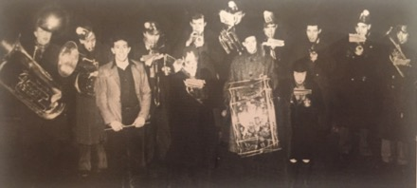
1) Représenter la communauté : le rôle central des brass bands dans la vie publique locale
b) Christmas Carols
Dalmellington Band, 1943.

Slide 18
Représenter la communauté : le rôle central des brass bands dans la vie publique locale
c) Processions funéraires
“Gresford”/ “The Miners’ Hymn”, Robert Saint, 1936
Catastrophe de Gresford, 1934
“Gresford” joué par Black Dyke Band (non daté): https://www.youtube.com/watch?v=2BjdaMGaVLs&t=107s

Slide 19
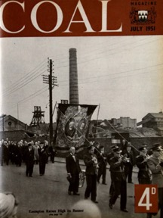
Représenter la communauté : le rôle central des brass bands dans la vie publique locale
c) Processions funéraires
Coal, juillet 1951.

Slide 20
Représenter la communauté : le rôle central des brass bands dans la vie publique locale
c) Processions funéraires
“The music was more than the sound that came from the instruments. It was the sorrow watching folk, the sorrow of a community. On the crimson banner there was the black drape of mourning, carried aloft as they carry their triumphs, but carried with a deeper pride.
Following the deep throb of the music and the tramp of marching feet came three hearses with the bodies of men who had grown up with band and banner, who had marched behind them with the same pride.”
Sid Chaplin, Coal, juillet 1951.

Slide 21
Les brass bands miniers: vitrines de l’industrie nationalisée
National Coal Board (NCB, 1947)
Coal, mai 1946 p. 6, NCM Online Digitised Collection (1947-1960): http://www.ncmonline.org.

Slide 22
Coal, septembre 1947, NCM Online Digitised Collection (1947-1960): http://www.ncmonline.org.

Slide 23
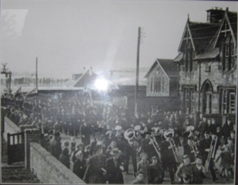
Dalmellington Band, 1947

Slide 24
Les brass bands miniers: vitrines de l’industrie nationalisée
Durham Miners’ Gala, 1947
« A band struck up the sad melody of a hymn in honour of dead miners. Heads were bared. There was a silence when singing ceased. »
Source: Coal, September 1947, p. 21

Slide 25
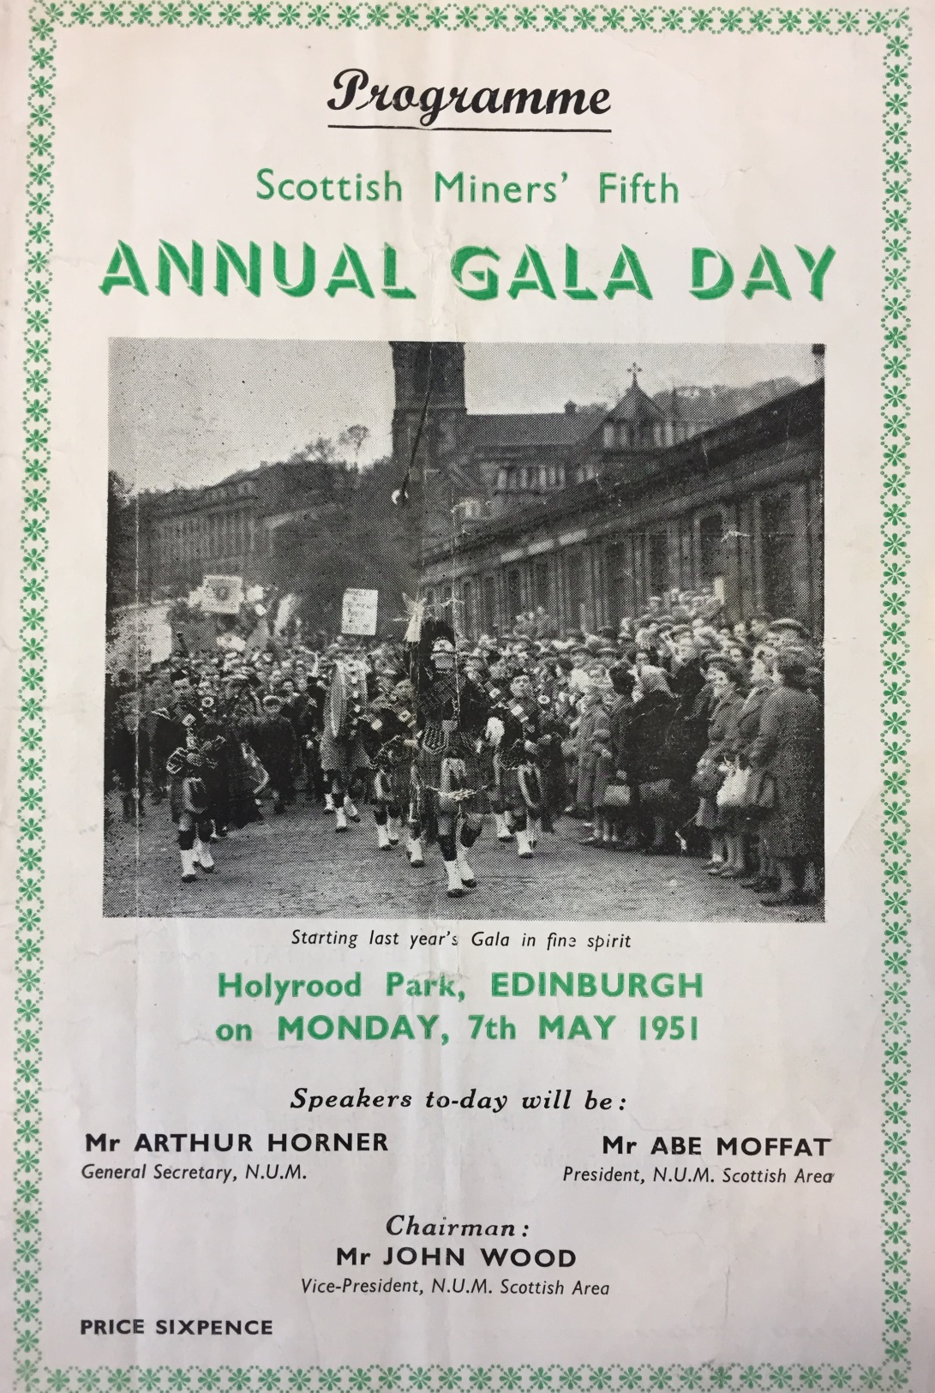
Le Scottish Miners’ Gala
National Mining Museum Scotland, Newtongrange, Programme du Scottish Miners’ Gala Day, 1951.

Slide 26
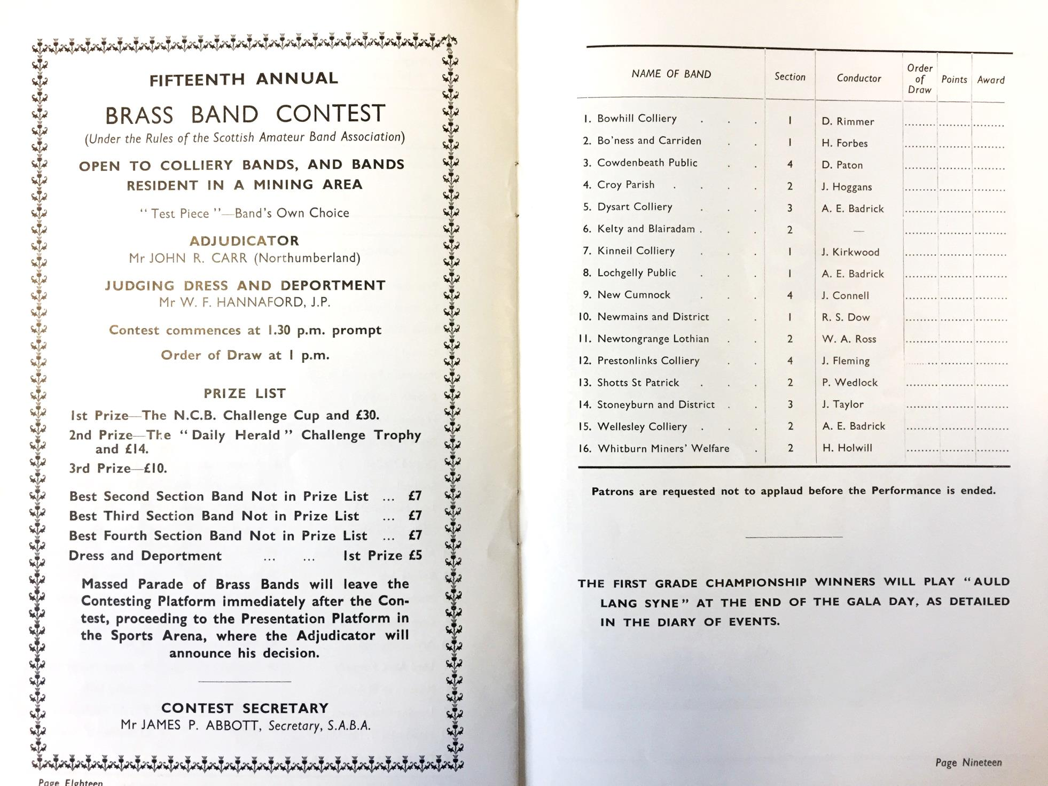
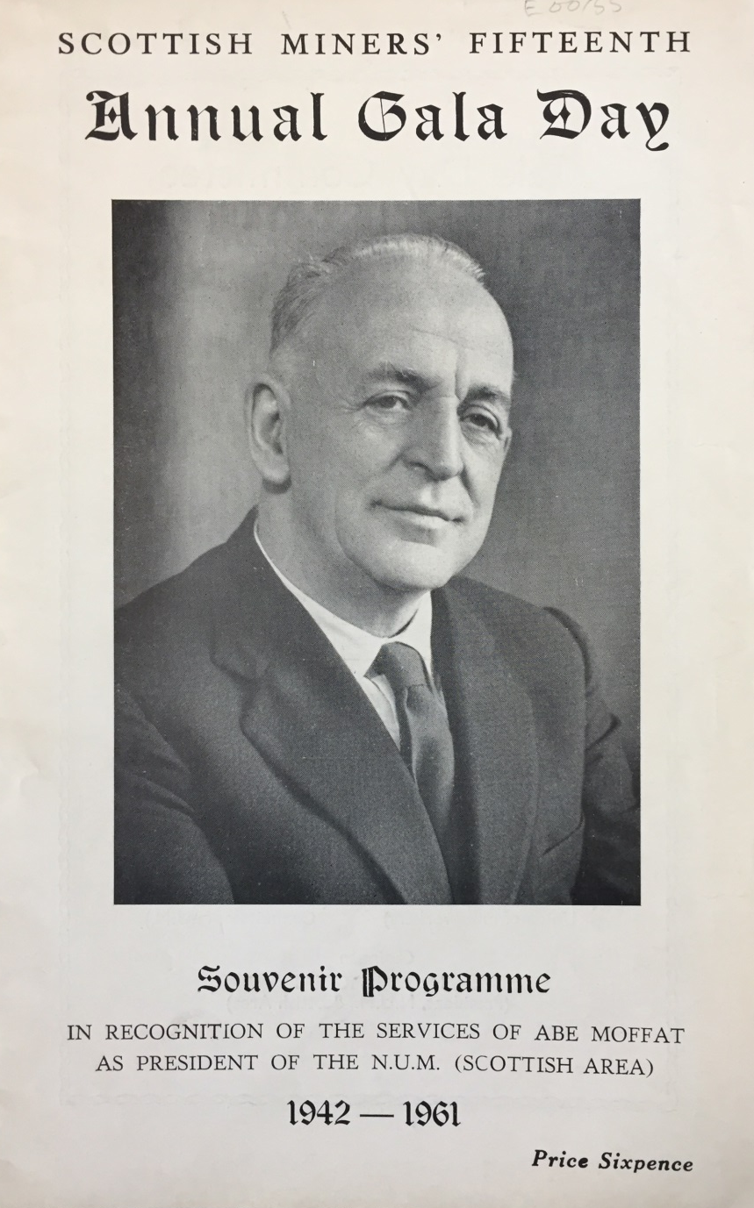
National Mining Museum Scotland, Newtongrange, Programme du Scottish Miners’ Gala Day, 1961

Slide 27
Conclusion

